Slide 1




IT Book Store
Group Code:
GHR_SWD3_S1e

Slide 2


Overview
Introduction
01
About Us
02
Problems
03
Objectives
04
Solutions
05
Explain
06
Our Team
07

Slide 3

Introduction
This project is a website for books in the field of technology. It contains a wide variety of books. You can purchase the books or add them to the Favorites section for easy access to the books you want to buy or plan to purchase in the future..

Slide 4
About us
We are students in the field of programming, trainees in the Digital Egypt Pioneers Initiative (DEPI) at the ITC company.
Company Overview
ITC College Academy was established in 2006 with the goal of achieving technological advancement in computers and languages. The Chairman of the Board is Professor Dr. Maher Mahmoud Raslan, who holds a Ph.D. from the University of Arkansas in Auditing, Project Evaluation, and Philosophy of Accounting, as well as a Master's degree in Accounting and Auditing Sciences from the University of Oklahoma. He is also a Professor of Accounting and Auditing at the Faculty of Commerce, Tanta University, and the Chairman of ITC, with a fellowship in Information Technology.

Slide 5
Problems
As a programmer, reading is one of the most important and best sources of learning in our world. No matter how good videos are, they may not provide us with complete information, as the lecturer might forget some details inadvertently. We find it difficult to access books related to our field, and We face many problems, including:
Problem 01
Problem 02
Problem 03
Difficulty accessing educational resources:
There was a problem with easily accessing reliable and up-to-date technology books and resources.
Diverse sources of books, which confuse the user:
Technology books are scattered across multiple platforms and various book stores, which confuses the user and makes it difficult to find the right book easily.
No way to organize future purchases of books:
A problem readers face is the inability to organize the books they wish to purchase in the future or even track the books they have added to their favorites list for later reference.

Slide 6


Objectives
Due to all these problems, we worked on providing a website that meets our needs.
And one of the most important of these objectives is:
Objective 01
Objective 02
Objective 03
The Favorites section is one of the most important objectives of our project, as it allows us to select multiple books. we can view these books and add them to the cart for purchase. It also allows us to compare them with other books and choose the best one to read or buy.
Creating a user-friendly website in terms of accessing books, with a search section that allows you to easily find the book you want.
Also, for ease of use, instead of searching, there is a Categories section you can use to easily access the section in which you want to read a book.

Slide 7

A simple and easy user interface has been created, and the feature of dark mode and light mode has been added to suit everyone and provide comfort for the eyes.
01
02
The Favorites section has been created for easy access to the favorite books that can be purchased later.
Solutions
03
Additionally, the required objective has been achieved by creating a Categories section to classify the books according to their type for ease of use.
04
A section for free books has been created to easily identify and download them for reading.

Slide 8
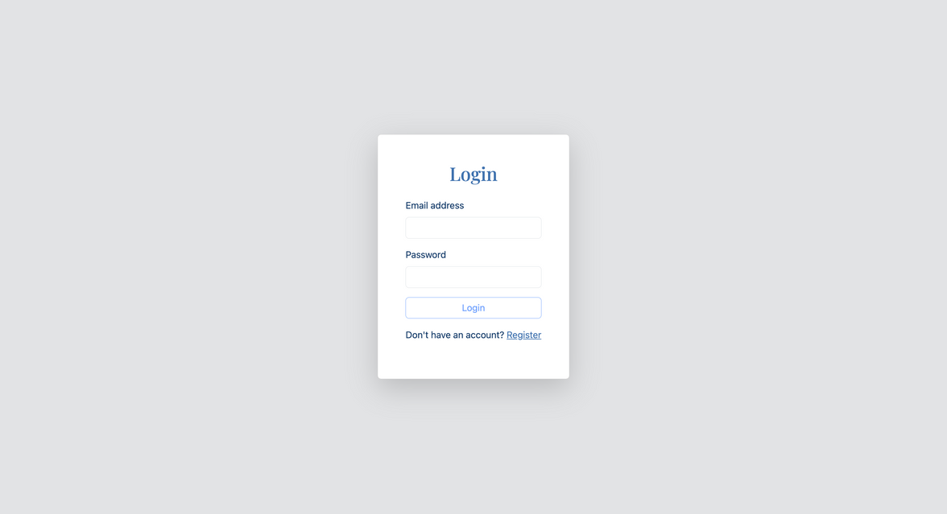
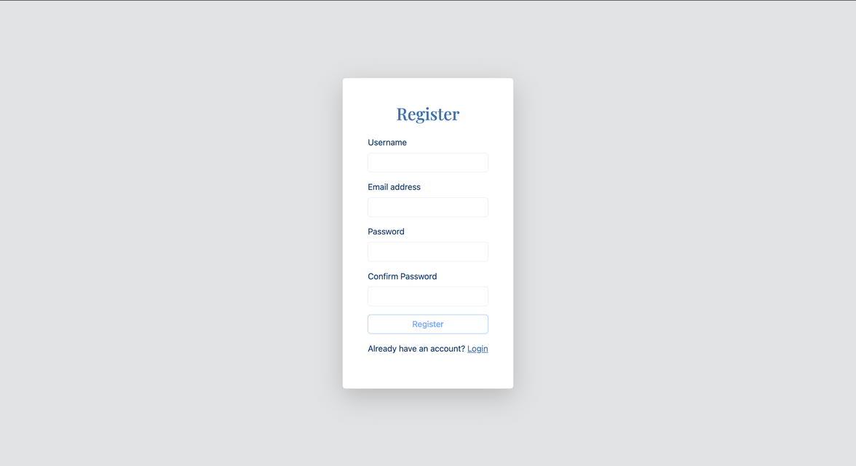
Register And Login

Slide 9
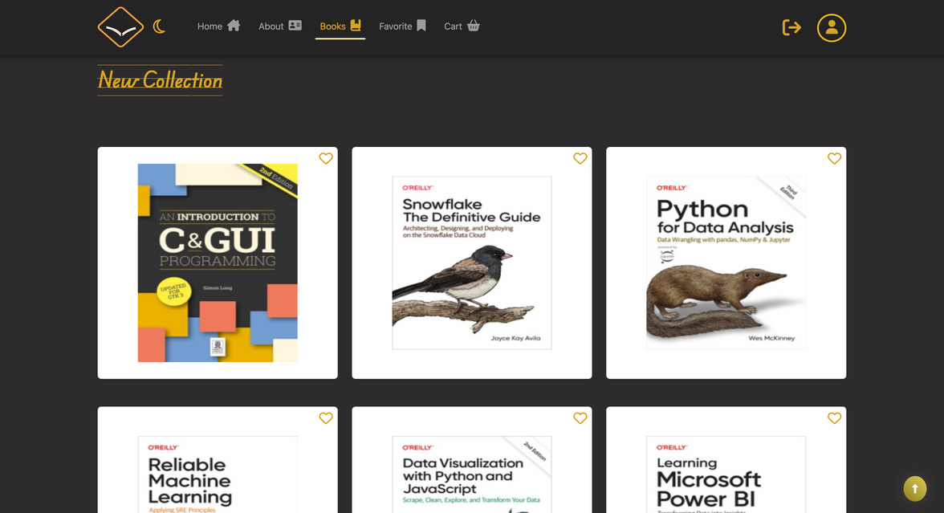
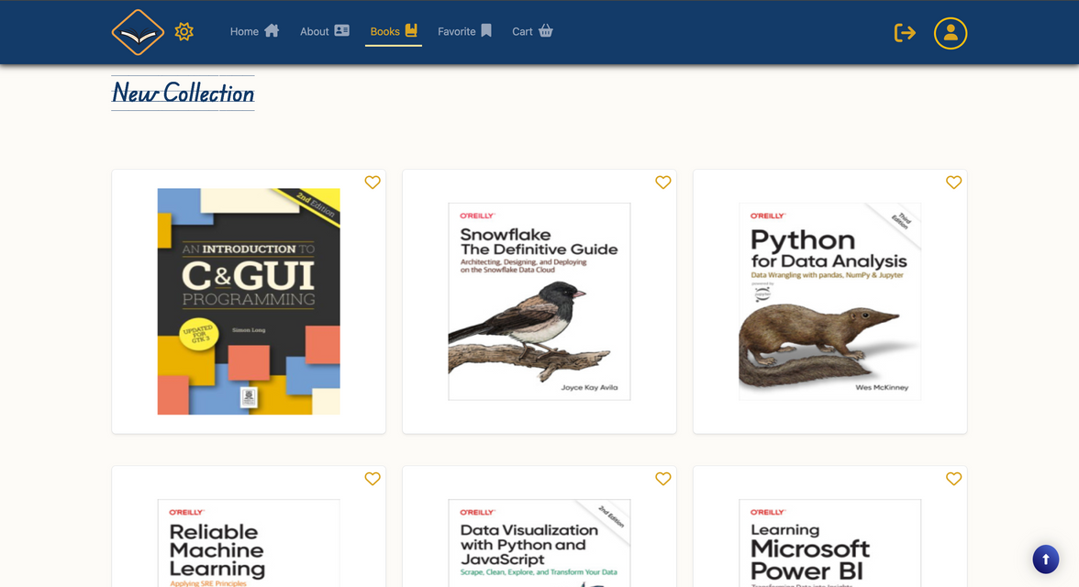
Dark Mode Vs Light Mode

Slide 10
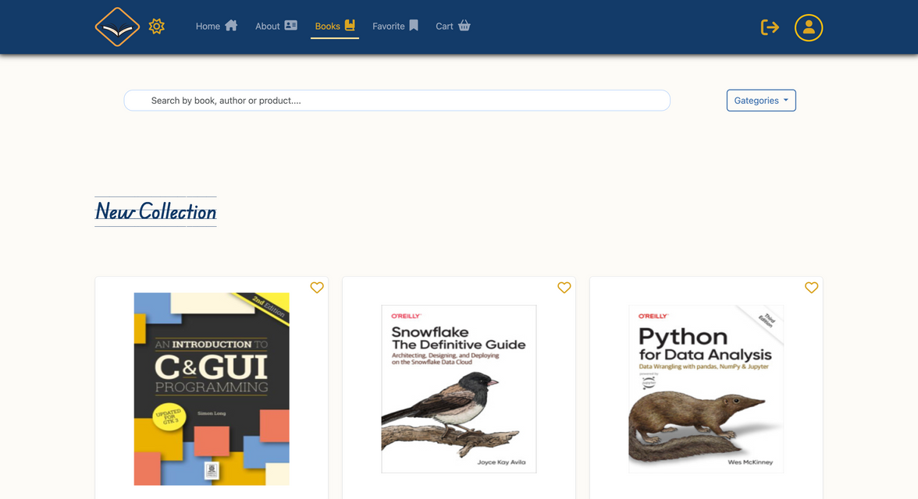
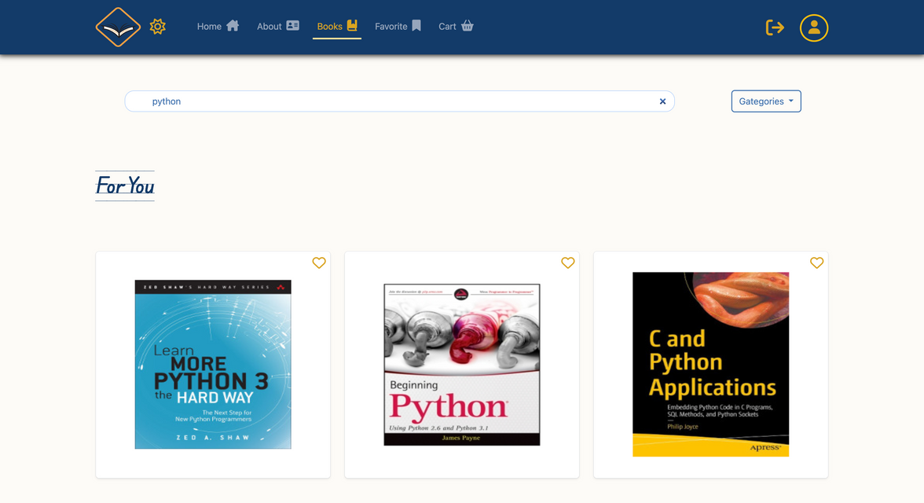
Search

Slide 11
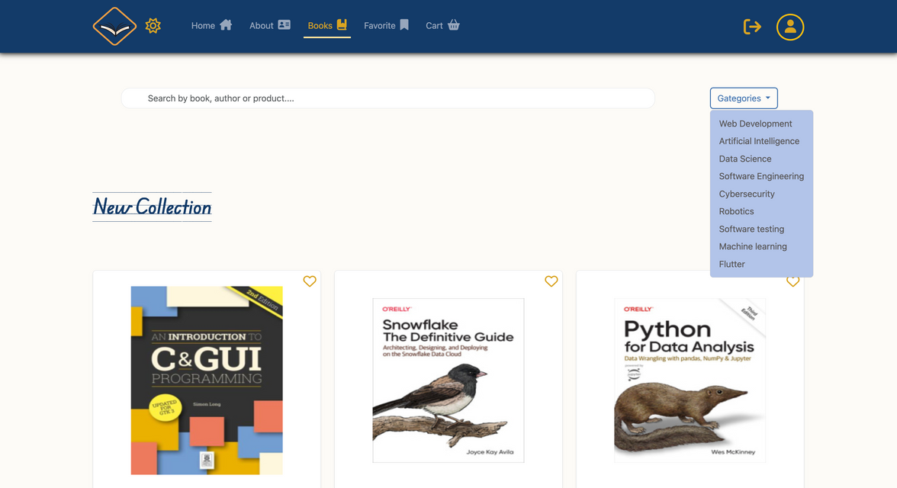
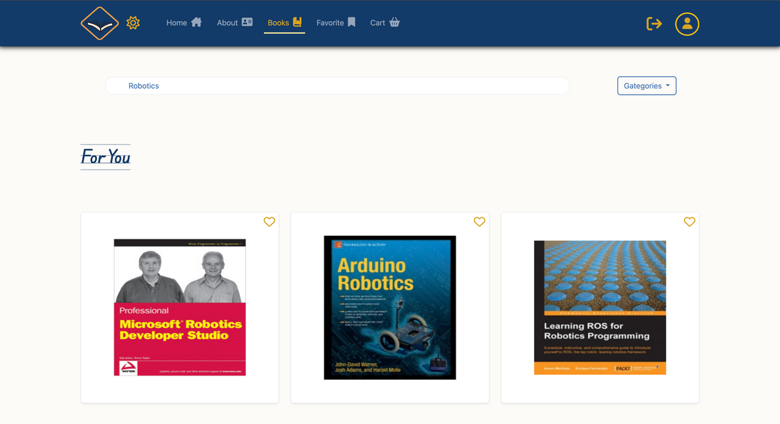
Category

Slide 12
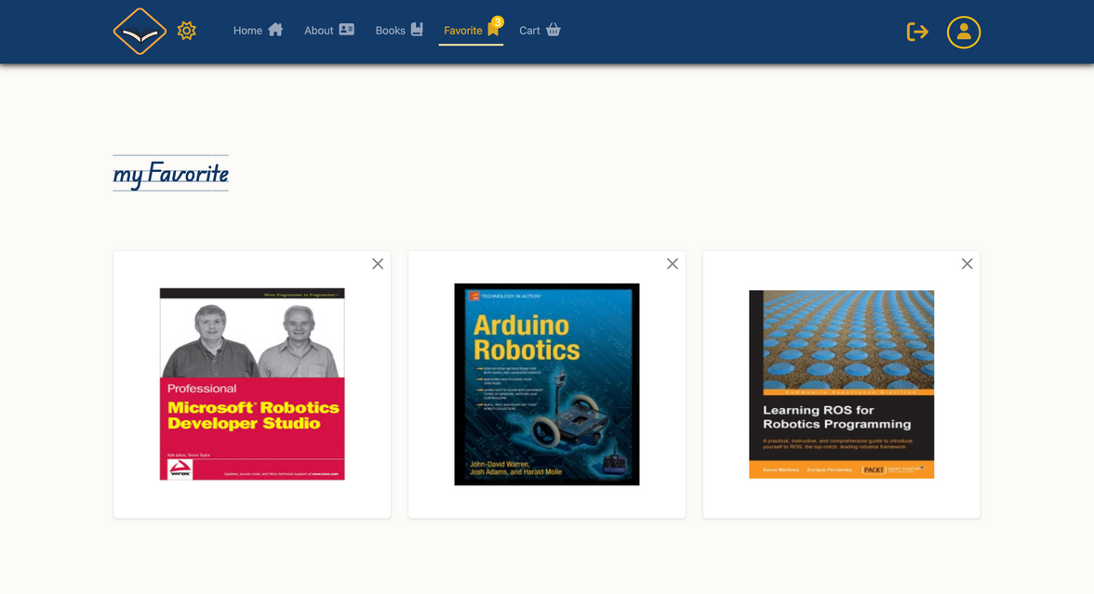
Favorite

Slide 13
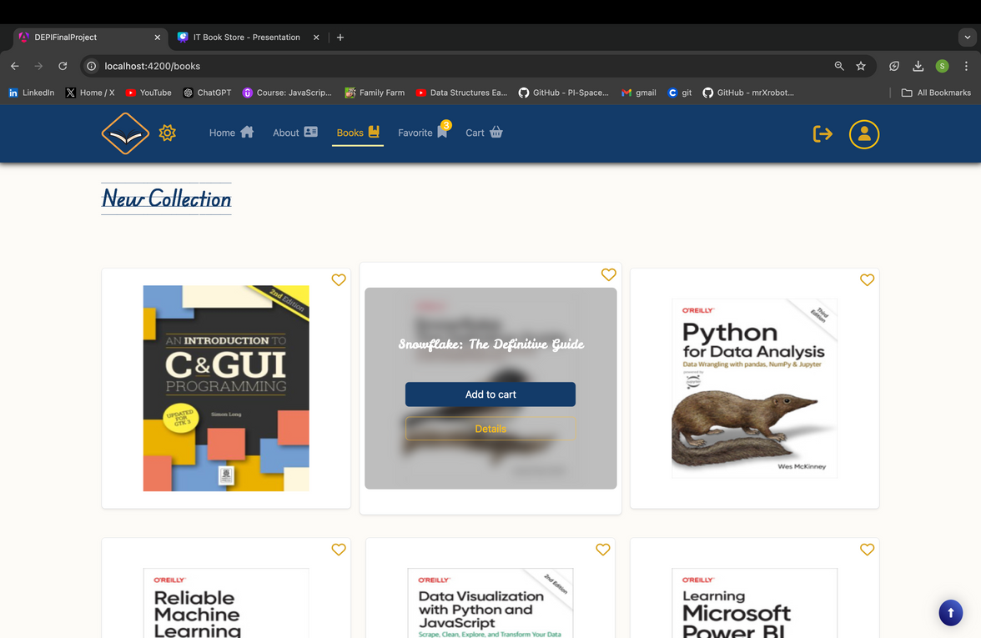
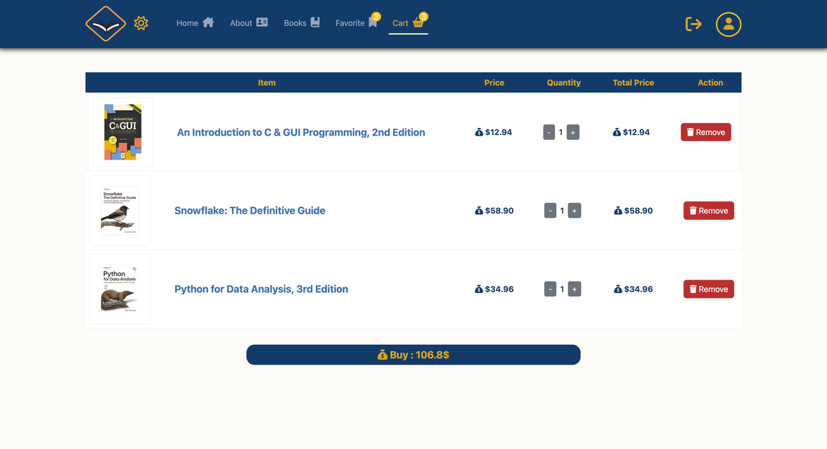
Cart

Slide 14
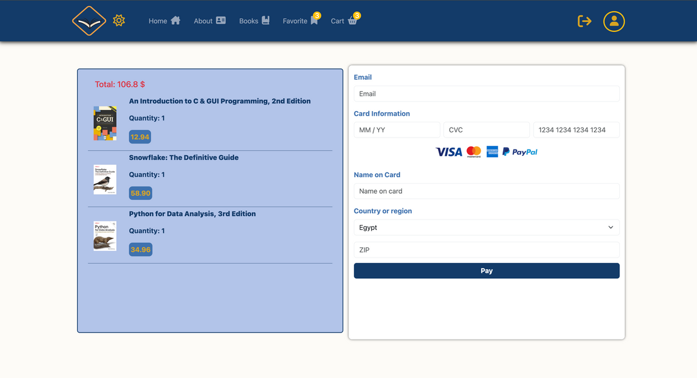
Purchase

Slide 15
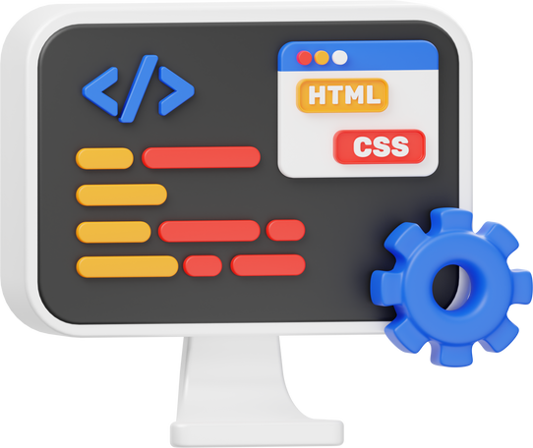
Our Team
Sherifa Mahmoud
Ahmed Hamed
Mohamed Reda
Frontend developer
Frontend developer
Frontend developer
Farah Ahmed
Ahmed Harfoush
Khairy Khaled
Frontend developer
Frontend developer
Frontend developer
Frontend developer
Mohamed Reda

Slide 16




THANK YOU!
ITC COLLAGE
+203-565-0321
https://itc-college.com/
Tanta Branch, 11 Luqman Al-Hakim, off Omar Ibn Abdul Aziz.

